Slide 1
Global PSP Project for Indian Embassies and Consulates
Quick Guide - Office Users’ Login

Slide 2
Login Using System-Generated (First Time Login) Password

Slide 3
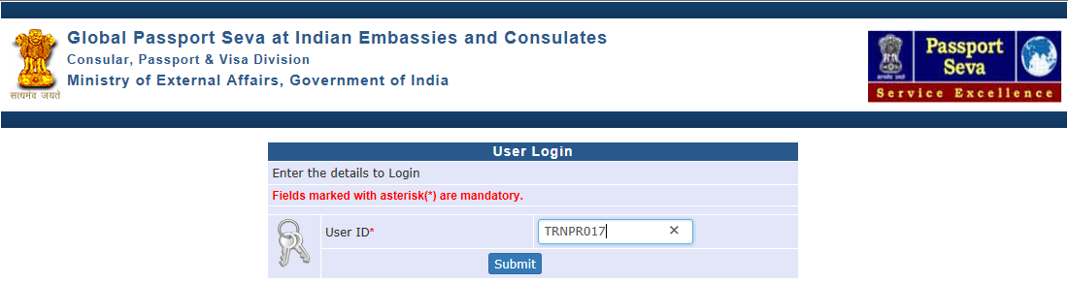
Login Using System-Generated Password
Visit Global PSP Office Portal (https://embassy.passportindia.gov.in)
Enter User ID
Press Submit button

Slide 4
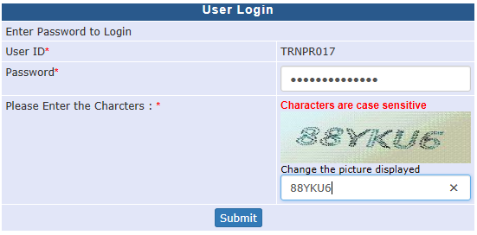
Login Using System-Generated Password (continued..)
Enter system-generated password received through Email
Enter characters displayed in the CAPTCHA image
Press Submit button

Slide 5
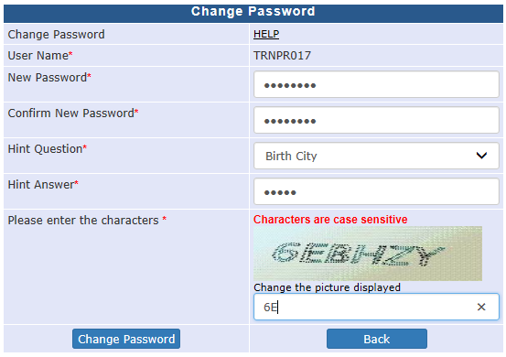
Login Using System-Generated Password (continued..)
Enter the new Password (required to be entered twice)
Choose a Hint Question from the drop-down menu
Enter the answer for the Hint Question (case sensitive). This will be useful to reset the password in case you forget the same.
Enter the characters displayed in the CAPTCHA image
Press Change Password button.

Slide 6

Login Using System-Generated Password (continued..)
Credential Updated Successfully message appears after successful validation of entered inputs.
Login using the newly reset password by clicking the ‘Click Here to Login’ link. Alternatively, you may re-type the Global PSP Office Portal (https://embassy.passportindia.gov.in) and login using the User ID and newly generated password

Slide 7
Login Using Self-Generated Password

Slide 8
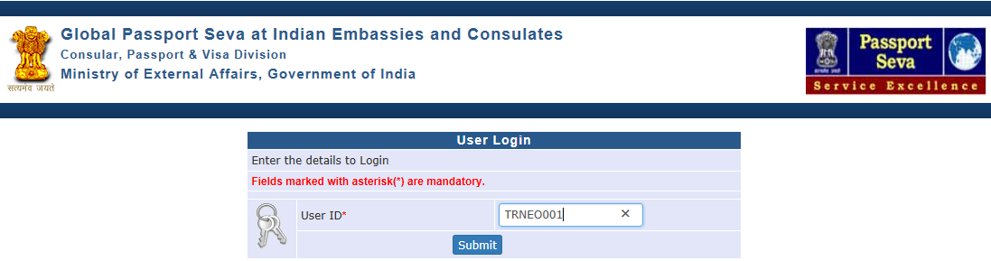
Login Using Self-Generated Password
Visit Global PSP Office Portal (https://embassy.passportindia.gov.in)
Enter User ID
Press Submit button

Slide 9
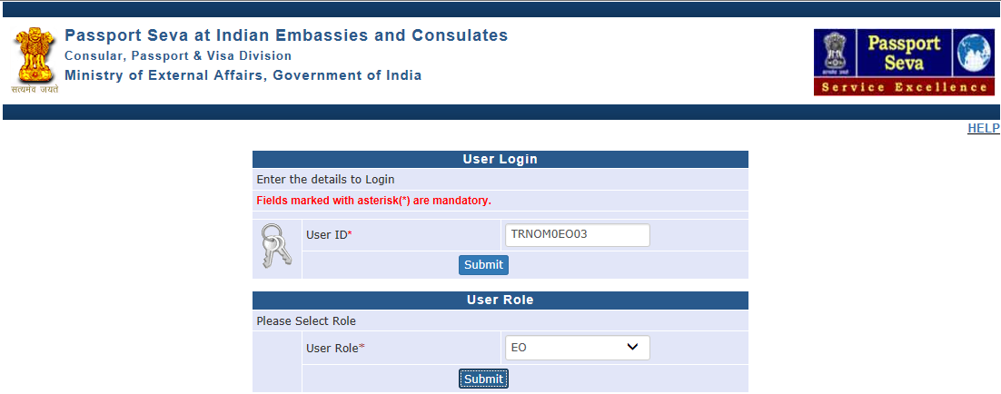
Login Using Self-Generated Password (continued..)
Choose User Role for login from the drop down menu
Press the Submit button displayed below the chosen User Role

Slide 10
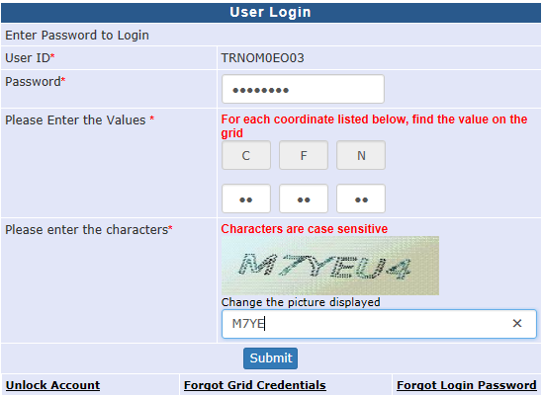
Login Using Self-Generated Password (continued..)
Enter the Password
Check your User Grid and enter the values for the three alphabets displayed on the screen
Enter the characters displayed in the CAPTCHA image
Press Submit button

Slide 11
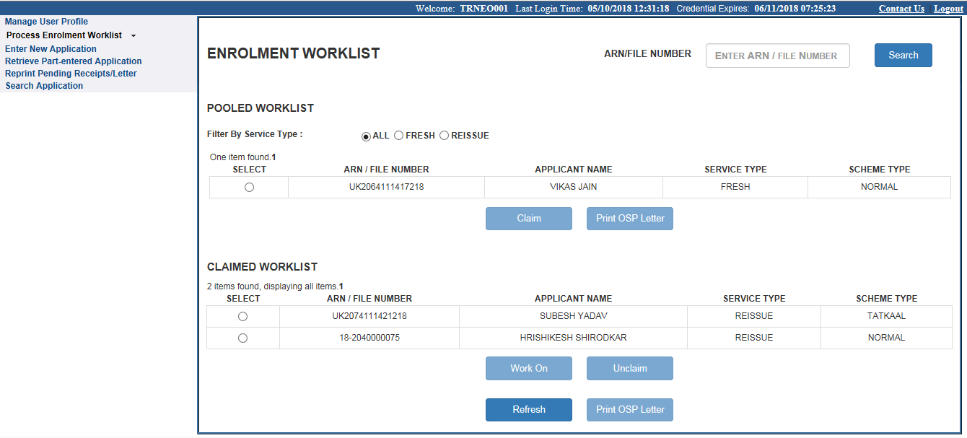
Login Using Self-Generated Password (continued..)
Application screens applicable for the chosen role will appear after Successful Authentication of User’s Password, Grid Values and CAPTCHA image

Slide 12
Unlock Account / Forgot Password

Slide 13
Unlock Account / Forgot Password / Regenerate Login Grid
Visit Global PSP Office Portal (https://embassy.passportindia.gov.in)
Enter User ID
Press Submit button
Choose User Role
Press Submit Button

Slide 14
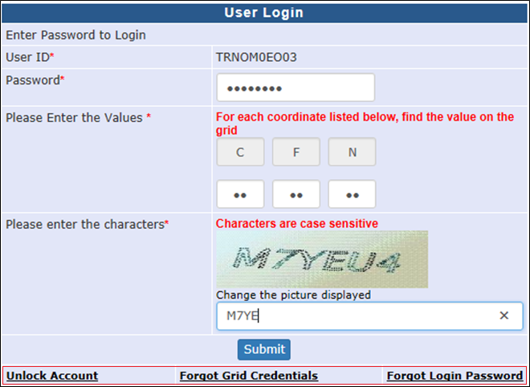
Unlock Account / Forgot Password / Regenerate Login Grid (continued..)
Click on “Unlock Account” if User Account is Locked
OR
Click on “Forgot Login Password” if you need to reset your password
OR
Click on “Forgot Grid Credentials” button if you need to regenerate the User Login Grid

Slide 15
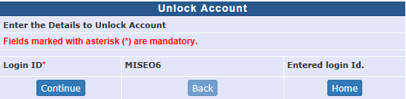
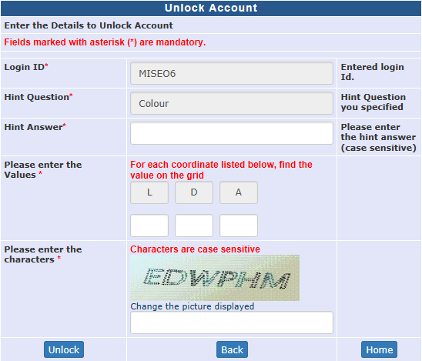
Unlock Account / Forgot Password / Regenerate Login Grid (continued..)
Unlock Account Case:
Click Continue after verifying the Login ID
Enter the Answer to Hint Question, Grid Values and characters displayed in the CAPTCHA image
Press Unlock button

Slide 16
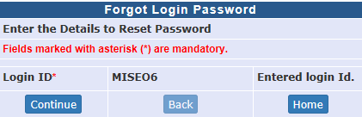
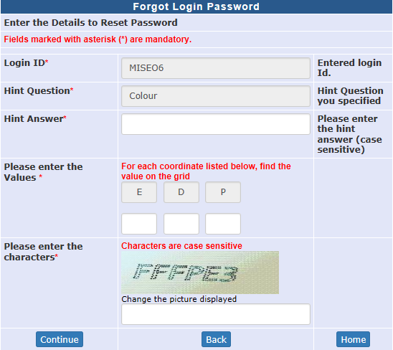
Unlock Account / Forgot Password / Regenerate Login Grid (continued..)
Forgot Login Password Case
Click Continue after verifying the Login ID
Enter the Answer to Hint Question, Grid Values and characters displayed in the CAPTCHA image
Press Unlock button

Slide 17
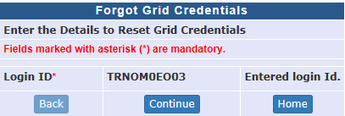
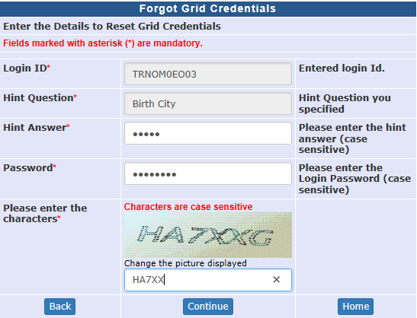
Unlock Account / Forgot Password / Regenerate Login Grid (continued..)
Forgot Grid Credentials Case
Click Continue after verifying the Login ID
Enter the Answer to Hint Question, Password and characters displayed in the CAPTCHA image
Press Continue button. System will display a success message and new grid credentials will be emailed to the user.

Slide 18
In case of additional information or clarification, please contact Central Support Team at psp.cst@tcs.com / +91 - 0120 - 6729595
Thank You

